Slide 1


Principals Of Programming Languages
Dr. saeed ur rehman
Department of Computer Science
COMSATS University Islamabad
Wah Campus

Slide 2
Biography
Ph.D. Control Science and Engineering( Pattern Recognition and Intelligent system)
University of Science and Technology of China [C9 China]
Research interest
Machine Vision
Pattern Recognition
Machine Learning

Slide 3

Chapter 1
Preliminaries

Slide 4
Chapter 1 Topics
Reasons for Studying Concepts of Programming Languages
Programming Domains
Language Evaluation Criteria
Influences on Language Design
Language Categories
Language Design Trade-Offs
Implementation Methods
Programming Environments

Slide 5
An example of an early computer
Harvard Mark I (IBM, Aiken, 1948)
electro-mechanical
– ENIAC is an electronic copy of Mark I design
executed 3 operations each second (3 IPS)
remained in use until 1959
51’ long, 8’ high, 3’ deep
730,000 parts (relays, switches, wheels, shafts), 530 miles of wiring, 18,000 vacuum tubes, ...
How many programmers could one ‘buy’ with the price of one computer?

Slide 6
An example of a new computer
Sun Fire 15K
106 UltraSPARC III processors
900 MHz to 1.2 GHz clock speed
29 million transistors
supports 4 Gb of memory
602,270 JBB operations per second
list price $3,739,230.00 (72 processors)

Slide 7
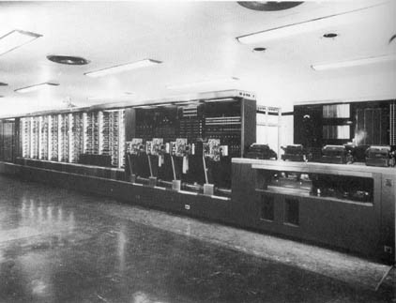
Picture of Mark I

Slide 8
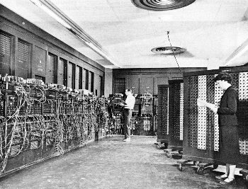
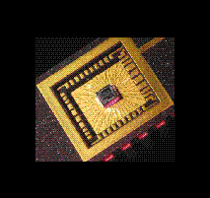
Computer Size
ENIAC then…
ENIAC today…
With computers (small) size does matter!

Slide 9

An example of an early program
Euclid’s algorithm for GCD (greatest common divisor)
actually this is for a quite new computer (MIPS R4000)
Writing programs in this way is very expensive and hard
but the early computers cost much much more
even using the computer cost more than programming it

Slide 10
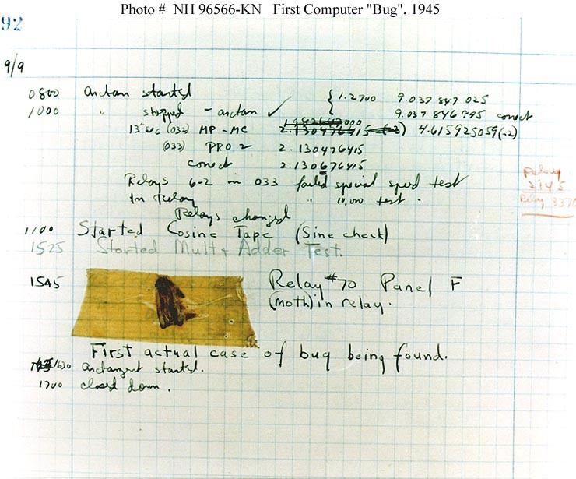
With Mark II came the bugs

Slide 11
Problems of machine code
Programming = coding in the true meaning of the word
Code is not
reusable: monolithic ‘structure’
relocatable: consider adding one instruction in the middle
readable (more important)
Practically impossible to create large programs

Slide 12
Symbolic assembly language
Assembler
translator from symbolic language to machine language (one-to-one mapping)
tool to assemble the symbolic program in the machine
Advantages
relocatable & reusable (copy) programs
macro expansion
first step towards higher-level programming
larger programs (like operating systems) possible

Slide 13
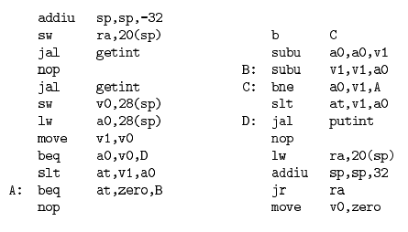
Euclid’s GCD program in MIPS assembly language

Slide 14
Problems of assembler
Each kind of computer has its own
Programmers must learn to think like computers
Maintenance of larger programs is difficult
Higher-level languages
portability
natural notation (for anything)
support to software development

Slide 15
First high-level language
Fortran (Backus, 1957)
IBM Mathematical Formula Translator
compilation instead of translation
language for scientific computing
most important task in those days
efficiency important to replace assemblers
introduced many important language concepts that are still in use

Slide 16
A Fortran program
C FORTRAN PROGRAM
DIMENSION A(99)
REAL MEAN
READ(1,5) N
5 FORMAT(I2)
READ(1,10) (A(I), I=1,N)
10 FORMAT(6F10.5)
SUM = 0.0
DO 15 I=1,N
15 SUM = SUM + A(I)
MEAN = SUM/FLOAT(N)
NUMBER = 0
DO 20 I=1,N
IF(A(I) .LE. MEAN) GOTO 20
NUMBER = NUMBER + 1
20 CONTINUE
WRITE(2,25) MEAN, NUMBER
25 FORMAT(8H MEAN = , F10.5, 5X,
20H NUMBERS OVER MEAN =, I5)
STOP
END

Slide 17
What matters in programming?
1950s: cost and use of machines
Nowadays
problems other than efficiency are often more important
performance gap between compiled and hand-tailored machine code has diminished
modern hardware is too complicated for humans
cost of labor has far surpassed the cost of machinery
standard PC costs like NT 20,000
software systems are getting more and more complex
problems to solve are getting difficult even to define

Slide 18
Why are there so many programming languages?
Evolution
CS is constantly finding ‘better’ ways to do things
structured programming, modules, o-o, ...
Special languages for special purposes
Scientific applications, e.g. MATLAB, Mathematica, Fortran, ALGO 60 etc.
Business applications, e.g. COBOL
Artificial intelligence (AI), e.g. LISP, Ada
Systems programming, e.g. PL/S, C/C++, Pascal
Web software, e.g. HTML, XML, PHP, .NET, Java
Personal preference
We are not all driving a NISSON or TOYOTA!?

Slide 19
Why are some programming languages more successful?
Expressive power
in principle, all languages are Turing-complete
has a huge effect on programmer’s ability to
write, read, and maintain
Understand and analyze
abstraction facilities (for computation & data)
Ease of use
low learning curve (Basic, Logo, Pascal)
Ease of implementation
Pascal & p-code (forefather of Java VM) made it easy to port compilers
free availability in general

Slide 20
More reasons for success
Excellent compilers and tools
fast compiled code (Fortran)
debugging tools
project management tools
teamwork tools
Economics, inertia
10000000 lines of Cobol is hard to rewrite
100000 Cobol programmers are hard to re-train
Patronage
many languages have powerful ‘sponsors’
Cobol, PL/I, Ada, Visual Basic, C#

Slide 21
Reasons for Studying Concepts of Programming Languages
Increased ability to express ideas
Improved background for choosing appropriate languages
Increased ability to learn new languages
Better understanding of significance of implementation
Overall advancement of computing

Slide 22
Programming Domains
Scientific applications
Large number of floating point computations
Fortran
Business applications
Produce reports, use decimal numbers and characters
COBOL

Slide 23
Programming Domains
Artificial intelligence
Symbols rather than numbers manipulated
LISP
Systems programming
Need efficiency because of continuous use
C
Web Software
Eclectic collection of languages: markup (e.g., XHTML), scripting (e.g., PHP), general-purpose (e.g., Java)

Slide 24
Language Evaluation Criteria
Readability: the ease with which programs can be read and understood
Writability: the ease with which a language can be used to create programs
Reliability: conformance to specifications (i.e., performs to its specifications)
Cost: the ultimate total cost

Slide 25
Evaluation Criteria: Readability
Overall simplicity
A manageable set of features and constructs
Few feature multiplicity (means of doing the same operation)
Minimal operator overloading
Orthogonality
A relatively small set of primitive constructs can be combined in a relatively small number of ways
Every possible combination is legal
Control statements
The presence of well-known control structures (e.g., while statement)

Slide 26
Evaluation Criteria: Readability
Data types and structures
The presence of adequate facilities for defining data structures
Syntax considerations
Identifier forms: flexible composition
Special words and methods of forming compound statements
Form and meaning: self-descriptive constructs, meaningful keywords

Slide 27
Evaluation Criteria: Writability
Simplicity and orthogonality
Few constructs, a small number of primitives, a small set of rules for combining them
Support for abstraction
The ability to define and use complex structures or operations in ways that allow details to be ignored
Expressivity
A set of relatively convenient ways of specifying operations
Example: the inclusion of for statement in many modern languages

Slide 28
Evaluation Criteria: Reliability
Type checking
Testing for type errors
Exception handling
Intercept run-time errors and take corrective measures
Aliasing
Presence of two or more distinct referencing methods for the same memory location
Readability and writability
A language that does not support “natural” ways of expressing an algorithm will necessarily use “unnatural” approaches, and hence reduced reliability

Slide 29
Evaluation Criteria: Cost
Training programmers to use language
Writing programs (closeness to particular applications)
Compiling programs
Executing programs
Language implementation system: availability of free compilers
Reliability: poor reliability leads to high costs
Maintaining programs

Slide 30
Evaluation Criteria: Others
Portability
The ease with which programs can be moved from one implementation to another
Generality
The applicability to a wide range of applications
Well-definedness
The completeness and precision of the language’s official definition

Slide 31
Influences on Language Design
Computer Architecture
Languages are developed around the prevalent computer architecture, known as the von Neumann architecture
Programming Methodologies
New software development methodologies (e.g., object-oriented software development) led to new programming paradigms and by extension, new programming languages

Slide 32
Computer Architecture Influence
Well-known computer architecture: Von Neumann
Imperative languages, most dominant, because of von Neumann computers
Data and programs stored in memory
Memory is separate from CPU
Instructions and data are piped from memory to CPU
Basis for imperative languages
Variables model memory cells
Assignment statements model piping
Iteration is efficient

Slide 33
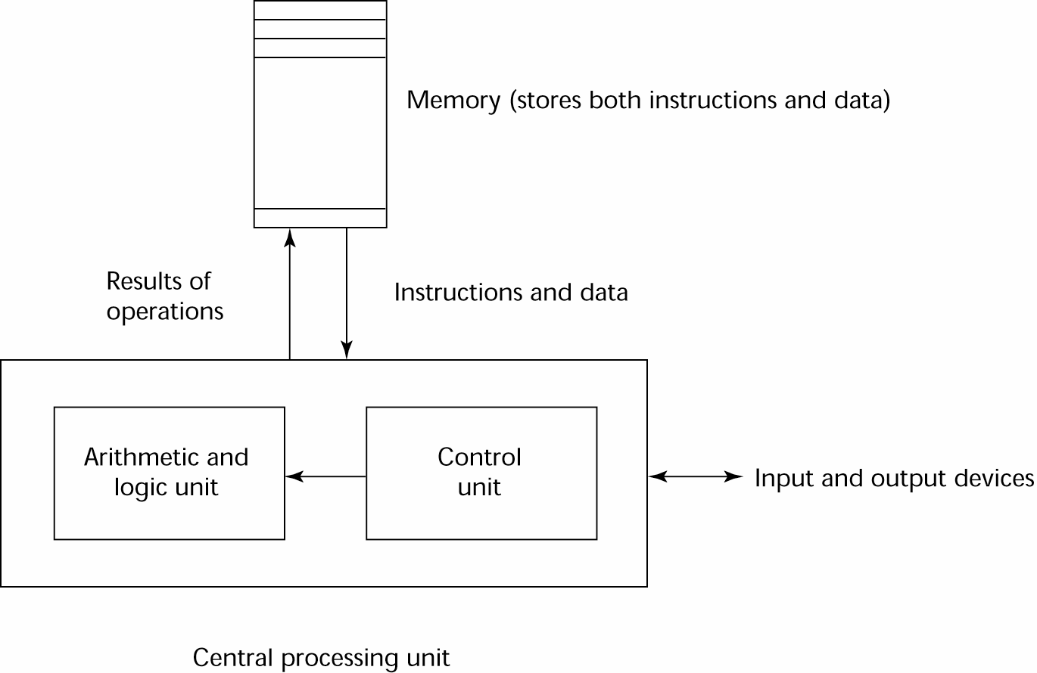
The von Neumann Architecture

Slide 34
Programming Methodologies Influences
1950s and early 1960s: Simple applications; worry about machine efficiency
Late 1960s: People efficiency became important; readability, better control structures
structured programming
top-down design and step-wise refinement
Late 1970s: Process-oriented to data-oriented
data abstraction
Middle 1980s: Object-oriented programming
Data abstraction + inheritance + polymorphism

Slide 35
Language Categories
Imperative
Central features are variables, assignment statements, and iteration
Examples: C, Pascal
Functional
Main means of making computations is by applying functions to given parameters
Examples: LISP, Scheme
Logic
Rule-based (rules are specified in no particular order)
Example: Prolog

Slide 36
Language Categories
Object-oriented
Data abstraction, inheritance, late binding
Examples: Java, C++
Markup
New; not a programming per se, but used to specify the layout of information in Web documents
Examples: XHTML, XML

Slide 37
Language Design Trade-Offs
Reliability vs. cost of execution
Conflicting criteria
Example: Java demands all references to array elements be checked for proper indexing but that leads to increased execution costs
Readability vs. writability
Another conflicting criteria
Example: APL provides many powerful operators (and a large number of new symbols), allowing complex computations to be written in a compact program but at the cost of poor readability
Writability (flexibility) vs. reliability
Another conflicting criteria
Example: C++ pointers are powerful and very flexible but not reliably used

Slide 38
Implementation Methods
Compilation
Programs are translated into machine language
Pure Interpretation
Programs are interpreted by another program known as an interpreter
Hybrid Implementation Systems
A compromise between compilers and pure interpreters

Slide 39
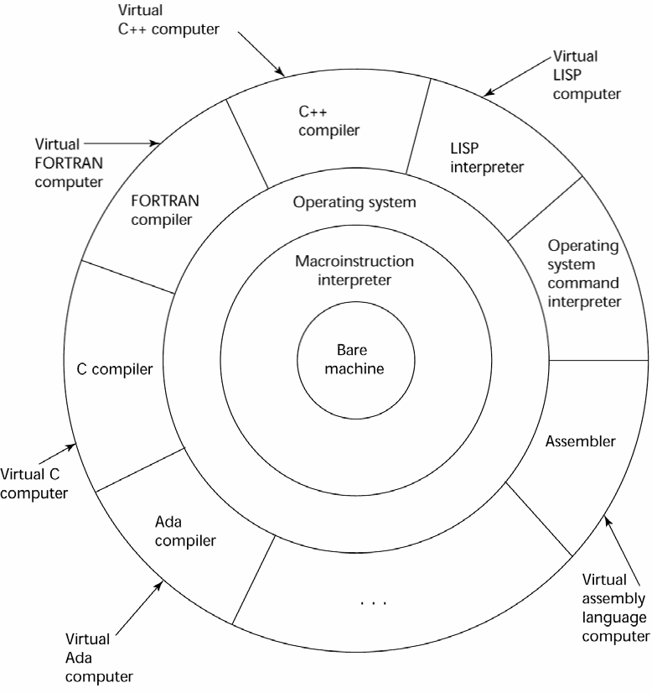
Layered View of Computer
The operating system and language implementation are layered over machine interface of a computer

Slide 40
Compilation
Translate high-level program (source language) into machine code (machine language)
Slow translation, fast execution
Compilation process has several phases:
lexical analysis: converts characters in the source program into lexical units
Syntax analysis: transforms lexical units into parse trees which represent the syntactic structure of program
Semantics analysis: generate intermediate code
code generation: machine code is generated

Slide 41
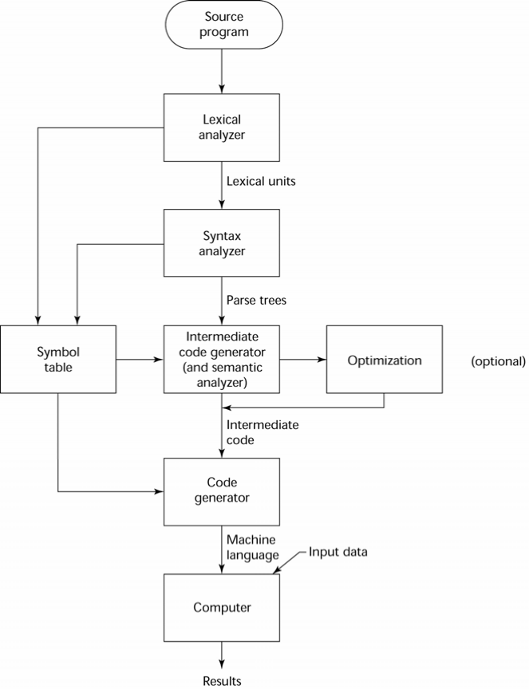
The Compilation Process

Slide 42
Additional Compilation Terminologies
Load module (executable image): the user and system code together
Linking and loading: the process of collecting system program and linking them to user program

Slide 43
Execution of Machine Code
Fetch-execute-cycle (on a von Neumann architecture)
initialize the program counter
repeat forever
fetch the instruction pointed by the counter increment the counter
decode the instruction execute the instruction
end repeat

Slide 44
Von Neumann Bottleneck
Connection speed between a computer’s memory and its processor determines the speed of a computer
Program instructions often can be executed a lot faster than the above connection speed; the connection speed thus results in a bottleneck
Known as von Neumann bottleneck; it is the primary limiting factor in the speed of computers

Slide 45
Pure Interpretation
No translation
Easier implementation of programs (run- time errors can easily and immediately displayed)
Slower execution (10 to 100 times slower than compiled programs)
Often requires more space
BecSignificant comeback with some Web scripting languages (e.g., JavaScript)
oming rare on high-level languages

Slide 46
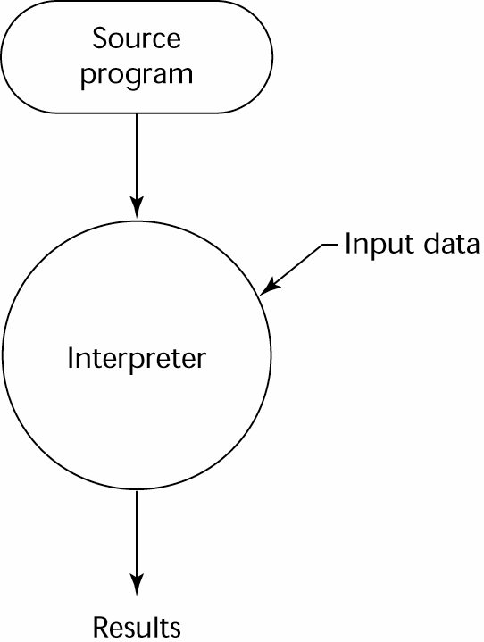
Pure Interpretation Process

Slide 47
Hybrid Implementation Systems
A compromise between compilers and pure interpreters
A high-level language program is translated to an intermediate language that allows easy interpretation
Faster than pure interpretation
Examples
Perl programs are partially compiled to detect errors before interpretation
Initial implementations of Java were hybrid; the intermediate form, byte code, provides portability to any machine that has a byte code interpreter and a run-time system (together, these are called Java Virtual Machine)

Slide 48
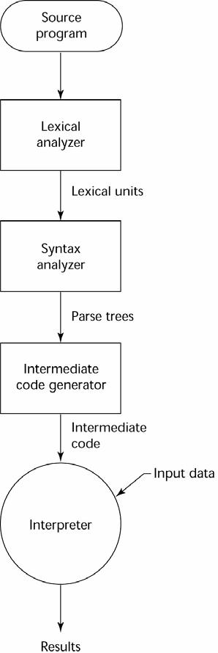
Hybrid Implementation Process

Slide 49
Just-in-Time Implementation Systems
Initially translate programs to an intermediate language
Then compile intermediate language into machine code
Machine code version is kept for subsequent calls
JIT systems are widely used for Java programs
.NET languages are implemented with a JIT system

Slide 50
Preprocessors
Preprocessor macros (instructions) are commonly used to specify that code from another file is to be included
A preprocessor processes a program immediately before the program is compiled to expand embedded preprocessor macros
A well-known example: C preprocessor
expands #include, #define, and similar macros

Slide 51
Programming Environments
The collection of tools used in software development
UNIX
An older operating system and tool collection
Nowadays often used through a GUI (e.g., CDE, KDE, or GNOME) that run on top of UNIX
Borland JBuilder
An integrated development environment for Java
Microsoft Visual Studio.NET
A large, complex visual environment
Used to program in C#, Visual BASIC.NET, Jscript, J#, or C++

Slide 52
Summary
The study of programming languages is valuable for a number of reasons:
Increase our capacity to use different constructs
Enable us to choose languages more intelligently
Makes learning new languages easier
Most important criteria for evaluating programming languages include:
Readability, writability, reliability, cost
Major influences on language design have been machine architecture and software development methodologies
The major methods of implementing programming languages are: compilation, pure interpretation, and hybrid implementation

Slide 53
TIOBI Index
The TIOBE Programming Community index is an indicator of the popularity of programming languages.
The index is updated once a month.
The ratings are based on the number of skilled engineers world-wide, courses and third-party vendors.
Popular search engines such as Google, Bing, Yahoo!, Wikipedia, Amazon, YouTube and Baidu are used to calculate the ratings.
It is important to note that the TIOBE index is not about the best programming language or the language in which most lines of code have been written.
https://www.tiobe.com/tiobe-index/

Slide 54
